Slide 1
Python Sequences
Tuples

Slide 2
Points to be Covered
What are Tuples ?
Different Operations on Tuples.
Indexing and Slicing in Tuples.
Iteration and Merge
Built in functions.
Advantages and Disadvantages of Tuples in Python.
references

Slide 3
What are Tuples in Python ?
Python Tuple is a collection of objects separated by commas. A tuple is similar to a Python list in terms of indexing, nested objects, and repetition but the main difference between both is Python tuple is immutable, unlike the Python list which is mutable.
Other difference between then is syntax : rather then using [] like lists, tuple is using () - round brackets.

Slide 4
What is Immutable in Tuples?
Like Lists, tuples are ordered and we can access their elements using their index values
We cannot update items to a tuple once it is created.
Tuples cannot be appended or extended.
We cannot remove items from a tuple once it is created.

Slide 5
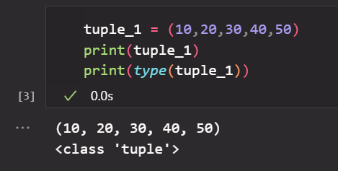
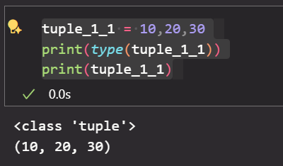
Operation on Tuples : Create Operation
to create a tuple follow this example:

Slide 6
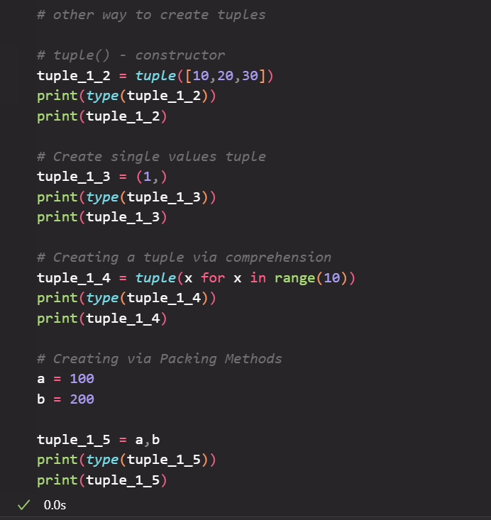
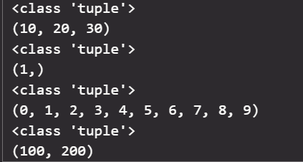
Operation : Create
Output :

Slide 7
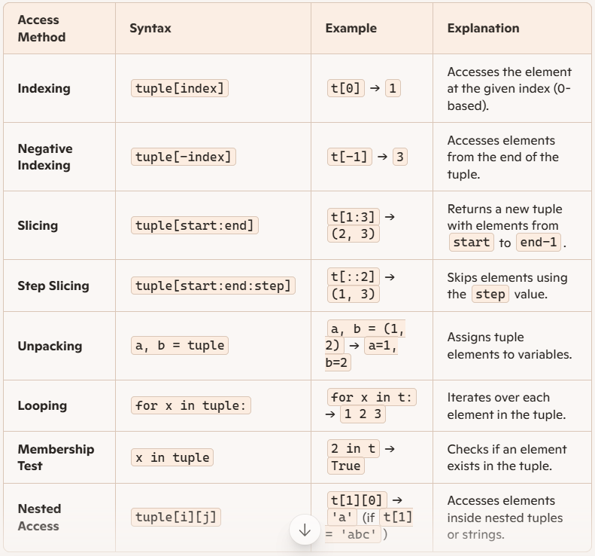
Operation : Access (Slicing and Indexing) Practical is Covered in Basic_Practical Folder

Slide 8
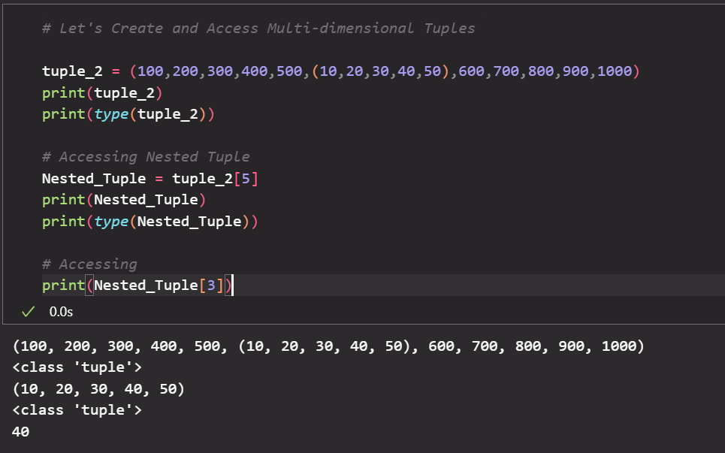
Create and Access : Nested Tuples

Slide 9
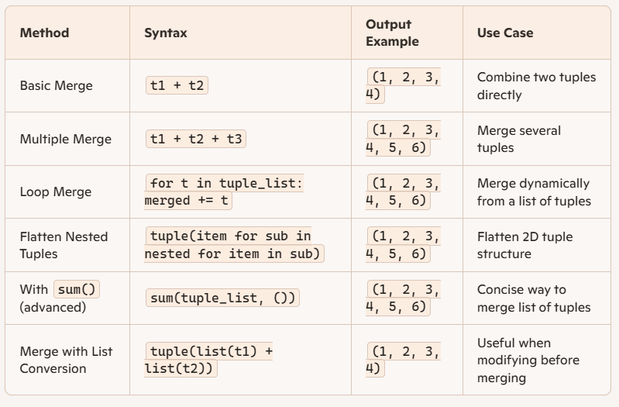
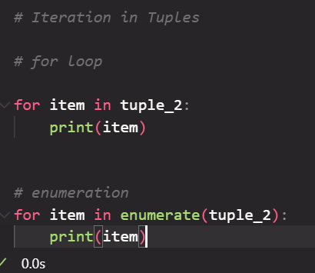
Access : Iteration and Merging in tuples
Refer example from Practical File

Slide 10
Simple Buit in functions for Access the Tuples
t = (10, 20, 30, 40, 50)
print(len(t)) # 5
print(max(t)) # 50
print(min(t)) # 10
print(sum(t)) # 150
print(sorted(t)) # [10, 20, 30, 40, 50]
print(t.index(30)) # 2
print(t.count(20)) # 1

Slide 11
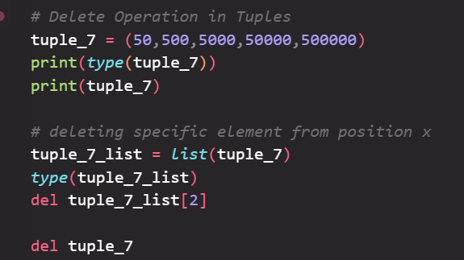
Deleting element from Tuples.
using del keyword.
tuple_1 = (10,20,30,40,50)
tuple_1 = list(tuple_1) //because tuple is not supporting direct element deletion operation!
del tuple_1[0] // simpe element deletion
del tuple_1 // it will delete whole tuple.

Slide 12
Update Operation
# Update Operation
Update is not directly Possible on Tuples because it is immutable.
But Like Deletion Operation We can convert it into list and Update it!
Refer List Updation from it's Notes!

Slide 13
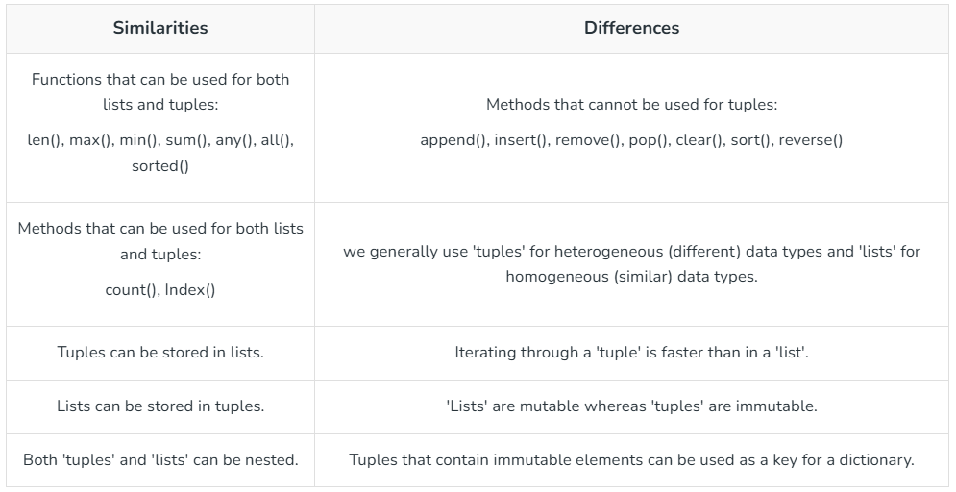
Tuples vs Lists

Slide 14
Advantages of Tuples
Immutable → safer and prevents accidental changes
Faster than lists → better performance
Hashable → usable as dictionary keys and set elements
Memory-efficient → uses less space than lists
Supports unpacking → cleaner, readable code
Ideal for fixed-size, structured data

Slide 15
Disadvantages of Tuples
Cannot be modified → no append, remove, or item assignment
Less flexible than lists for dynamic data
No built-in methods like append(), remove(), etc.
Harder to update → requires conversion to list
Not ideal for frequently changing datasets

Slide 16
Dictionary - as a python sequences
Topics : Various Operation (Creation,Access - Indexing and Slicing, merging, iterating, Built-in Functions, Deletion, Updation, Dictionaries and Nested Dictionary, Advantages and Disadvatages)

Slide 17
What is Dictionary ?
Python dictionary is a data structure that stores the value in key: value pairs.
Values in a dictionary can be of any data type and can be duplicated, whereas keys can't be repeated and must be immutable.

Slide 18
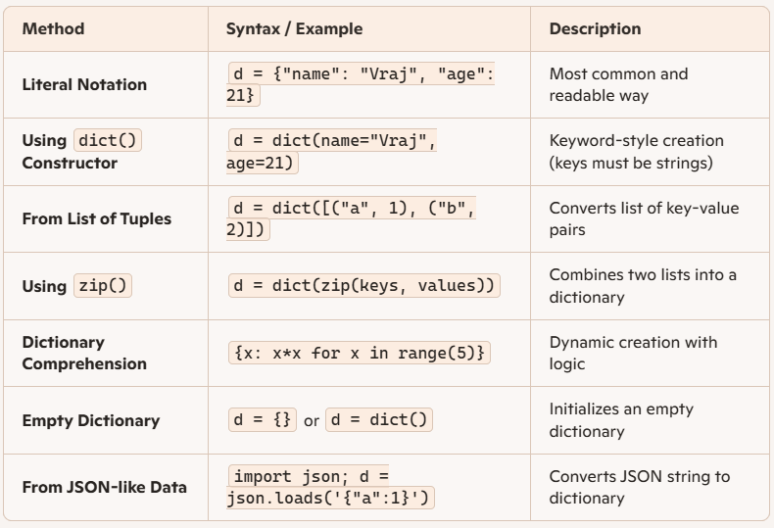
Operation : Create
We Can Create Dictionaries in multiple ways.

Slide 19
Some points about it:
Dictionary keys are case sensitive.
Keys must be immutable.
Keys must be unique.
ictionary internally uses Hashing. Hence, operations like search, insert, delete can be performed in Constant Time.

Slide 20
Operation: Access
d = { "name": "Prajjwal", 1: "Python", (1, 2): [1,2,4] }
# Access using key
print(d["name"])
# Access using get()
print(d.get("name"))

Slide 21
Operation : Adding and Updating Dictionary Items
d = {1: 'Geeks', 2: 'For', 3: 'Geeks'}
# Adding a new key-value pair
d["age"] = 22
# Updating an existing value
d[1] = "Python dict"
print(d)

Slide 22
Delete Operation
del: Removes an item by key.
pop(): Removes an item by key and returns its value.
clear(): Empties the dictionary.
popitem(): Removes and returns the last key-value pair.
** Practicals are given into Dictionary.ipynb

Slide 23
Iterating Through a Dictionary
d = {1: 'Geeks', 2: 'For', 'age':22}
# Iterate over keys
for key in d:
print(key)
# Iterate over values
for value in d.values():
print(value)
# Iterate over key-value pairs
for key, value in d.items():
print(f"{key}: {value}")

Slide 24
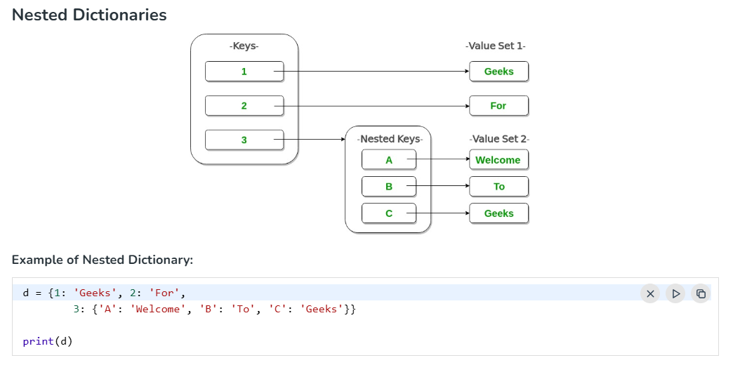
Nested Dictionary

Slide 25
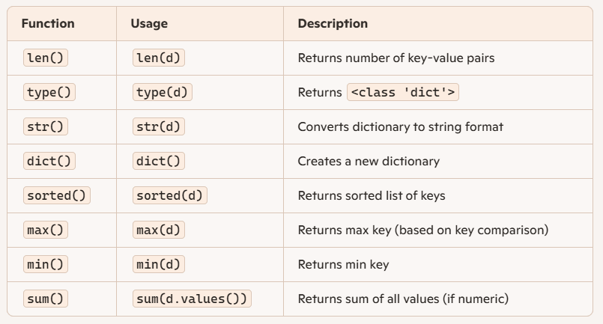
Built-in functions

Slide 26
Advantages
Fast Lookup: Constant-time access using keys (hashing-based)
Flexible Data Storage: Can store any data type as values, including lists, tuples, and other dicts
Semantic Clarity: Key-value structure makes data self-descriptive
Dynamic Size: Can grow or shrink as needed
Built-in Methods: Rich set of methods for manipulation (get(), update(), etc.)
Supports Nesting: Ideal for representing JSON-like hierarchical data
Used in Real-World Scenarios: Perfect for configs, caching, API payloads, and more

Slide 27
Disadvantages
Unordered (pre-Python 3.7): No guaranteed order before Python 3.7
Memory Overhead: Uses more memory than lists or tuples.
Keys Must Be Hashable: Can't use lists or other mutable types as keys.
No Indexing/Slicing: Can't access elements by position like lists.
Less Predictable in Iteration: Order of items may vary (in older versions)
Mutable: Can be accidentally modified if not handled carefully

Slide 28
Note:
The Topics of Index and Slicing is Given in Practical File which also contain Practical Part of Each Portion.

Slide 29
Sets in Python!
A Set in Python is used to store a collection of items with the following properties.
No duplicate elements. If try to insert the same item again, it overwrites previous one.
An unordered collection. When we access all items, they are accessed without any specific order and we cannot access items using indexes as we do in lists.
Internally use hashing that makes set efficient for search, insert and delete operations. It gives a major advantage over a list for problems with these operations.
Mutable, meaning we can add or remove elements after their creation, the individual elements within the set cannot be changed directly.

Slide 30
NOTE : ADD MATERIAL ABOUT ARE GIVEN IN PRACTICAL FILE : Sets.ipynb

Slide 31
references
https://www.geeksforgeeks.org/python/tuples-in-python/
https://docs.python.org/3/tutorial/datastructures.html#tuples-and-sequences
https://copilot.microsoft.com/

